Slide 1
Perfect Competition
HS201

Slide 2

Introduction
A perfectly competitive market is one in which economic forces operate unimpeded.
The theory of perfect competition has its roots in late-19th century economic thought.
Léon Walras was the first economist who presented a rigorous definition of PC. In the 1950s,Kenneth Arrow and Gérard Debreu have further formalized the theory of PC.

Slide 3

Requirements for PC
  A perfectly competitive market must meet the following requirements:
  Both buyers and sellers are price takers
  The number of firms is large
  There are no barriers to entry
  The firms’ products are identical
  There is complete information
  Firms are profit maximizers

Slide 4
The Necessary Conditions for PC
Both buyers and sellers are price takers.
  A price taker is a firm or individual who takes the market price as given.
  In most markets, households are price takers – they accept the price offered in stores.

Slide 5
The Necessary Conditions for PC
  The number of firms is large
  Large means that what one firm does has no bearing on what other firms do.
  Any one firm's output is little when compared with the total market.

Slide 6
The Necessary Conditions for PC
There are no barriers to entry.
  Barriers to entry are social, political, or economic impediments that prevent other firms from entering the market.
  Barriers sometimes take the form of patents granted to produce a certain good.

Slide 7
The Necessary Conditions for PC
  The firms' products are identical
  This requirement means that each firm's output is indistinguishable from any competitor's product.

Slide 8
The Necessary Conditions for PC
  There is complete information.
  Firms and consumers know all there is to know about the market – prices, products, and available technology.
  Any technological breakthrough would be instantly known to all in the market.

Slide 9
The Necessary Conditions for PC
Firms are profit maximizers
  The goal of all firms in a perfectly competitive market is profit and only profit.
  The only compensation firm owners receive is profit, not salaries.

Slide 10
Profit Maximization in PC
Profit maximization can be identified by a comparison of marginal revenue and marginal cost.
If MR = MC, then profit cannot be increased by changing the level of production.
Increasing production adds more to cost than revenue, meaning profit declines.
Decreasing production subtracts more from revenue than from cost, meaning profit also declines.

Slide 11
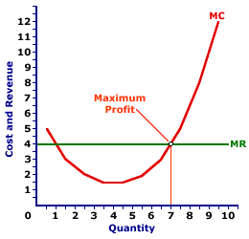
Fig-1
At larger or smaller output levels, marginal cost exceeds marginal revenue or marginal revenue exceeds marginal cost.

Slide 12
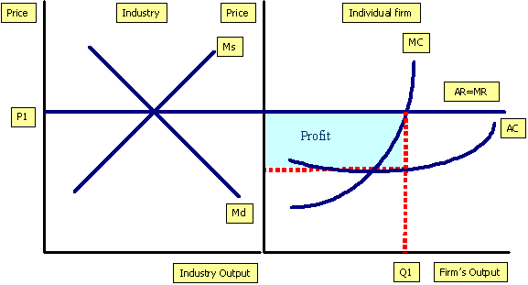
Short Run Profit
Fig.2

Slide 13
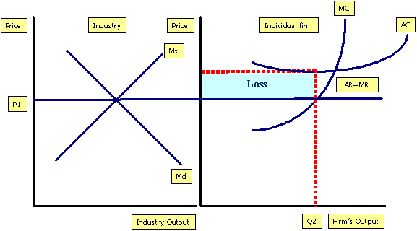
Short Run Loss
Fig-3

Slide 14
Long Run Price
If most firms are making abnormal profits in the short run
there will be an expansion of the output of existing firms
and we expect to see the entry of new firms into the industry.
Firms are responding to the profit motive
and supernormal profits act as a signal for a reallocation of resources within the market.

Slide 15
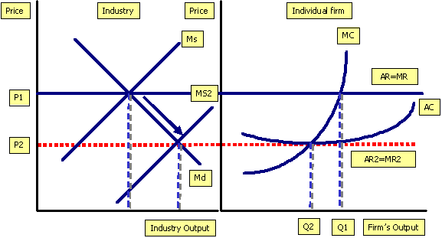
The addition of new suppliers: an outward shift in the market supply curve.
Fig-4

Slide 16
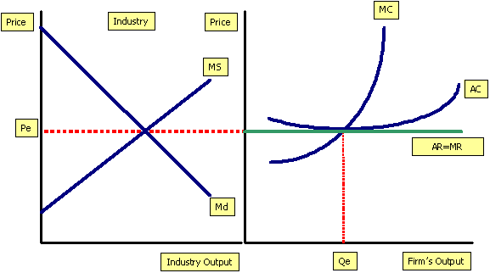
Long-run equilibrium
Fig-5

Slide 17
Price in the Long Run
In the long run price denoted as P will be presented as
P=AC=MC=AR=MR

